Slide 1



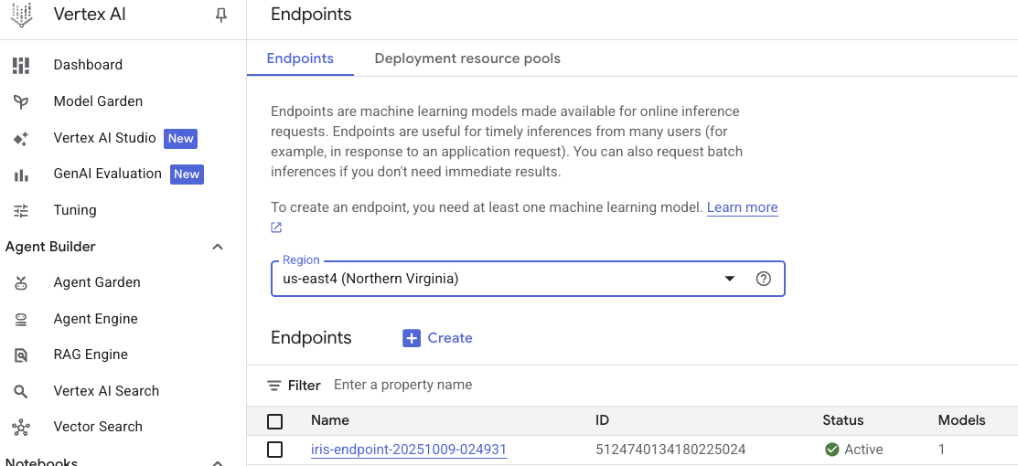

From Vertex AI to TinyLLM: Building Edge-Ready AI for Personalized Healthcare
Anton Rasmussen – CS795/895 Generative AI – Instructor: Dr. Hong Qin – Fall 2025
Old Dominion University, Norfolk, VA
Abstract
Phase I: Foundations
Phase III (Future Direction): Simulated Edge Network & Healthcare Vision
A multi-phase research and engineering effort on adapting Large Language Models (LLMs) for efficient edge deployment.
Phase I involves understanding Google Cloud Vertex AI for model training and deployment.
Phase II focuses on compressing open-source LLMs via post-training quantization for embedded systems.
Phase III envisions a decentralized network of compressed LLMs collaborating on edge devices for personalized, privacy-preserving healthcare insights.
End-to-End Model Deployment on Google Vertex AI
Objective: Train, register, and deploy a scikit-learn RandomForest model (Iris dataset) to a live Vertex AI endpoint.
Key Takeaways:
GCP workflow familiarity
Debugging serialization/version mismatches
Foundation for distributed model management
Edge-RAG for Personalized Health Intelligence
Concept: A network of embedded LLMs (each running a compressed TinyLLM) collaborating through local feedback loops.
Simulation Goals:
Emulate multi-device data flows (wearables, mobile app, home monitor)
Each node runs quantized LLM with RAG component
Periodic knowledge exchange without cloud dependency
Healthcare Use Case:
Aggregates signals from multiple edge devices (heart rate, sleep, activity)
Synthesizes personalized insights across devices → holistic health view
Future Steps:
Implement multi-node simulation in Vertex AI custom jobs or local containers
Explore federated learning integration
Evaluate privacy vs accuracy trade-offs
Problem / Challenge
LLMs are computationally intensive and often unsuitable for local deployment.
Sensitive healthcare data must remain private, limiting reliance on cloud-based inference.
There is a need for efficient, edge-compatible AI that can process personal data securely and in real time.
Goal: Develop and evaluate compressed, quantized TinyLLMs capable of operating collaboratively across embedded devices as a blueprint for decentralized health intelligence.
Phase II: TinyLLM Compression Project
Evaluating Post-Training Quantization for Edge-Ready LLMs
Goal: Apply GPTQ and AWQ to Phi-3 Mini to enable CPU/embedded inference
Method Overview:
Prepare datasets (WikiText-103, MMLU subset)
Quantize → 4-bit versions
Evaluate latency / perplexity / accuracy / memory footprint
Stretch: Add SparseGPT pruning for further compression.
Outcome: Portable CPU-runnable build (GGUF model) → runs locally via llama.cpp
References
Abdin et al. (2024). Phi-3 Technical Report. arXiv:2404.14219
Touvron et al. (2023). LLaMA-2: Open Foundation and Fine-Tuned Chat Models. arXiv:2307.09288
Frantar et al. (2022). GPTQ: Accurate Post-Training Quantization for Generative Pre-trained Transformers. arXiv:2210.17323
Lin et al. (2023). AWQ: Activation-Aware Weight Quantization for LLMs. arXiv:2306.00978
Merity et al. (2016). WikiText Language Modeling Dataset. Salesforce Research.
Available at:
https://www.salesforce.com/blog/the-wikitext-long-term-dependency-language-modeling-dataset/

